Slide 1
Introduction to Computer Science (371-1-1601)
Lectures by: Dr. Dan Vilenchik & Dr. Zion Siksik
Recitations by: Ariel Cohen, Moshiko Davidian, Assaf Livne, Yair Mazal

Slide 2
Recitation 9b Binary Trees

Slide 3
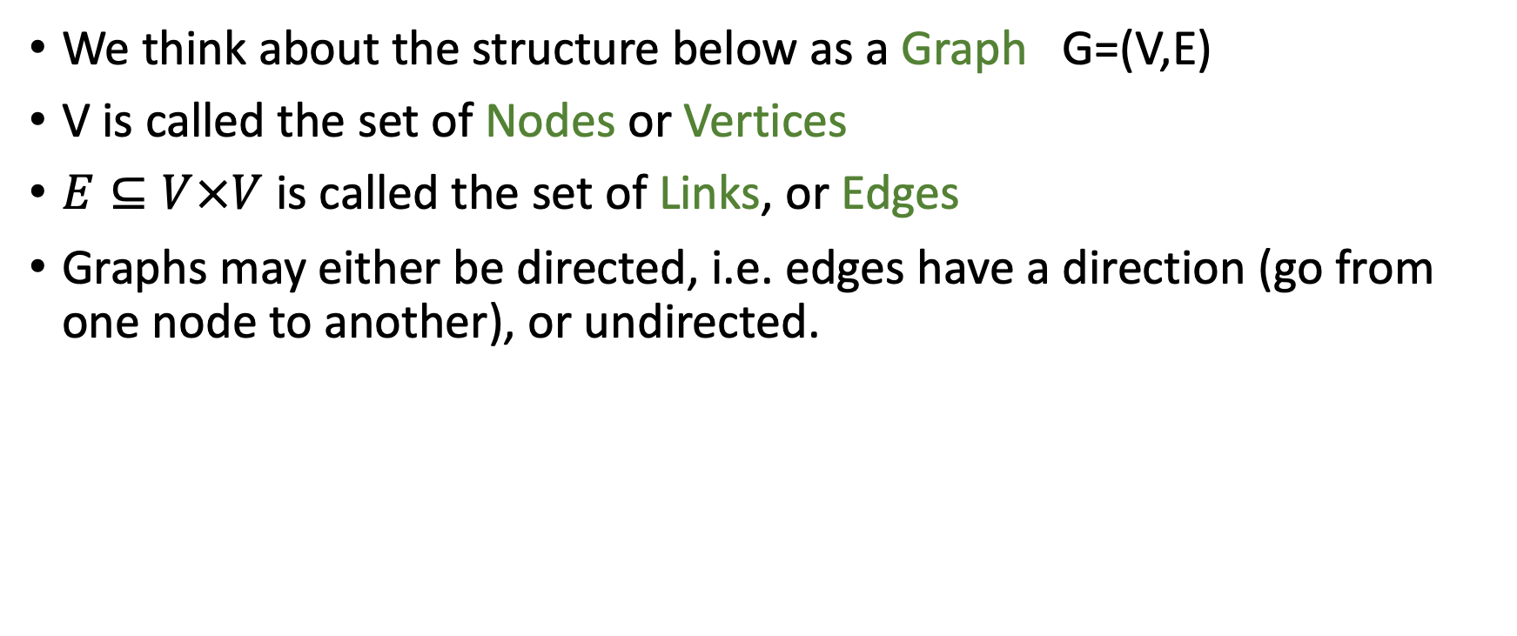
Graphs
We think about the structure below as a Graph G=(V,E)
V is called the set of Nodes or Vertices
$E⊆V×V$ is called the set of Links, or Edges
Graphs may either be directed, i.e. edges have a direction (go from one node to another), or undirected.
4
1
3
5
2

Slide 4
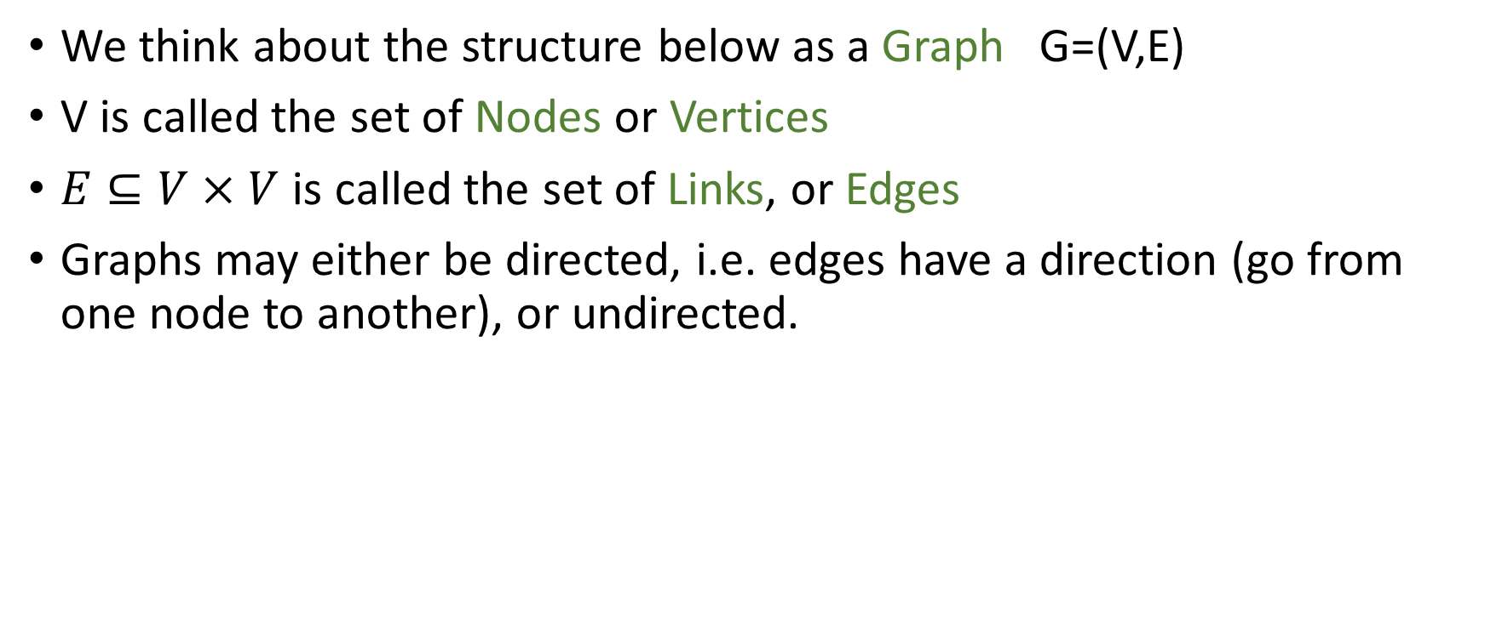
Graphs
We think about the structure below as a Graph G=(V,E)
V is called the set of Nodes or Vertices
$E⊆V×V$ is called the set of Links, or Edges
Graphs may either be directed, i.e. edges have a direction (go from one node to another), or undirected.
Is linked list a graph?
4
1
3
5
2

Slide 5
Trees
Directed Rooted Trees are one particularly useful class of Graphs.
They have a special node called “the root”
There is exactly one path from the root to every other node in the tree.
Binary trees have the further property that each node has at most two others beneath it. Is the tree to the right binary?
1
2
3
4
5
6
7
8

Slide 6
Binary Trees

Slide 7
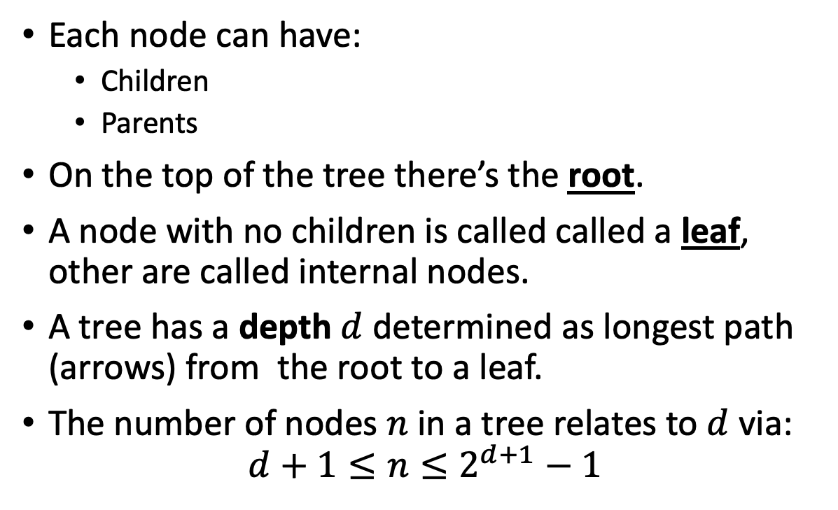
Tree Terminology
Each node can have:
Children
Parents
On the top of the tree there’s the root.
A node with no children is called called a leaf, other are called internal nodes.
A tree has a depth $d$ determined as longest path (arrows) from the root to a leaf.
The number of nodes $n$ in a tree relates to $d$ via:
$$d+1≤n≤2^{d+1}−1$$
1
2
3
5
6
7
8

Slide 8
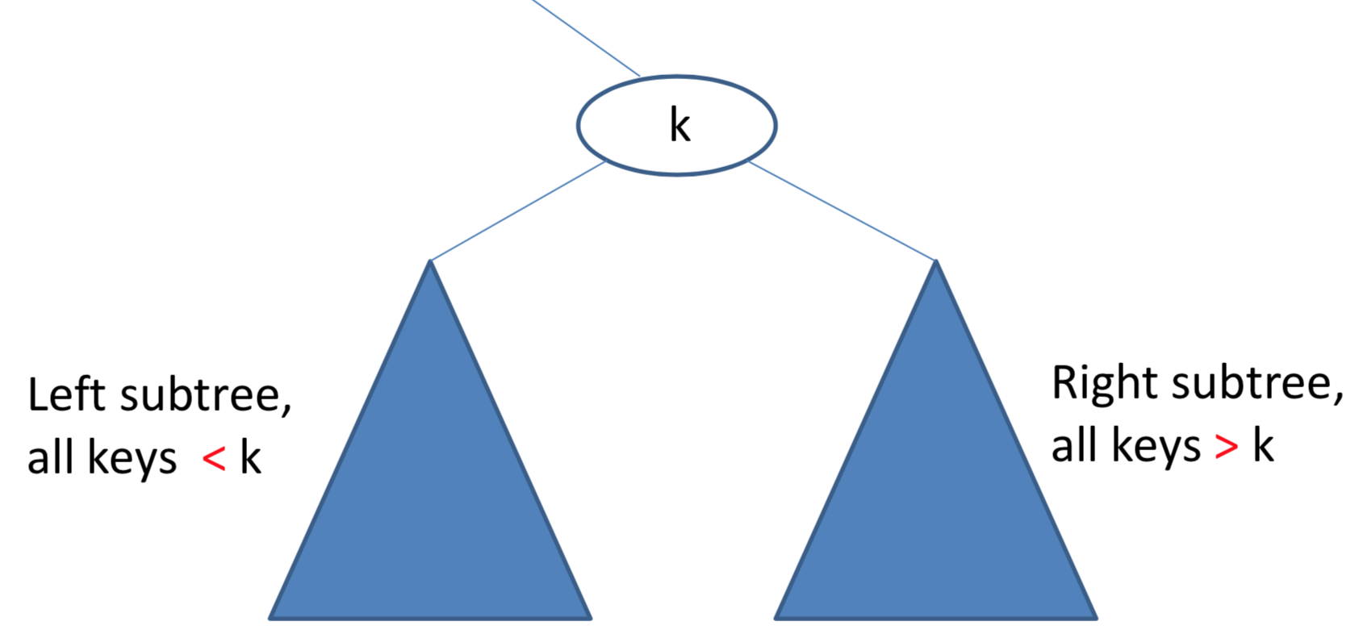
Binary Search Trees
Binary search trees have the additional property that they are ordered.
They have many uses

Slide 9
Exercise – Tree Lookup
Download the file “g_binary_tree_basic.py” from moodle.
Implement a method “find_val” for the class. The method accepts a single argument – a lookup value.
The method returns true if the value is found and false otherwise.
Remember the tree is binary search tree. Can this help you?

Slide 10
Lookup
def findval(self, lkpval) -> bool: if lkpval < self.data: if self.left is None: return False return self.left.findval(lkpval) elif lkpval > self.data: if self.right is None: return False return self.right.findval(lkpval) else: return True
12
12
6
14
3
8

Slide 11
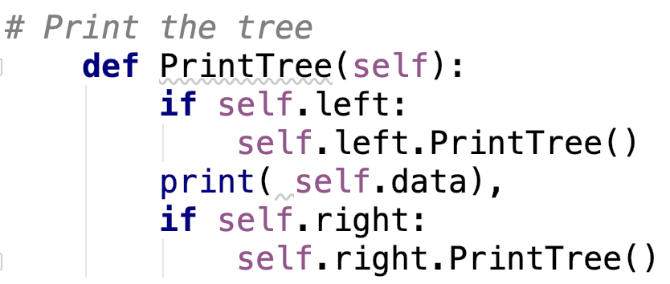
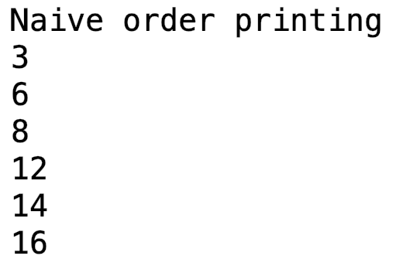
Traversing trees
12
12
Let us print a tree:
6
14
3
8
16
Can we print by depth?

Slide 12
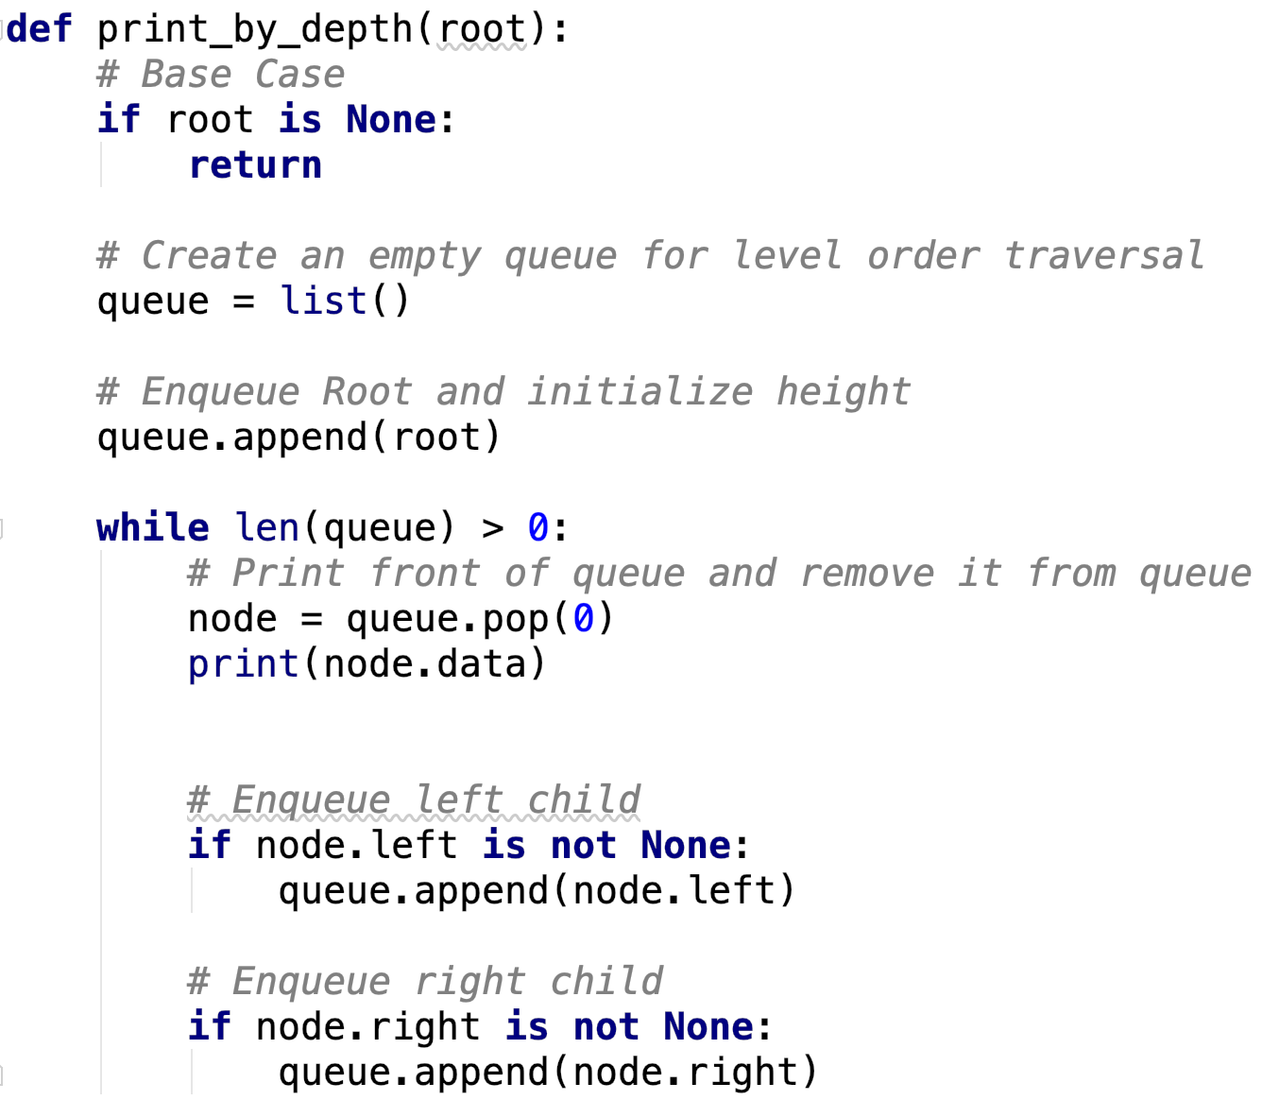
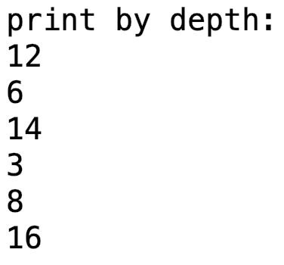
Print by depth – taken from here
12
12
6
14
3
8
16
We use a queue to alter the order
Breadth First Traversal
How would you print right before left?

Slide 13
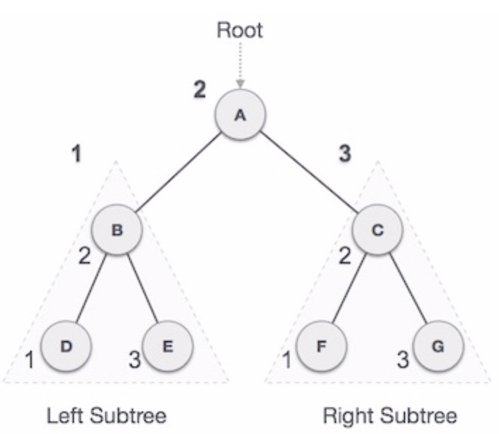
Standard traversal orders – In-Order
In-order Traversal - left subtree, root, right subtree
Good for generating sorted values in ascending order
Example of
Depth First Traversal
Uses a stack
Example without recursion:
here

Slide 14
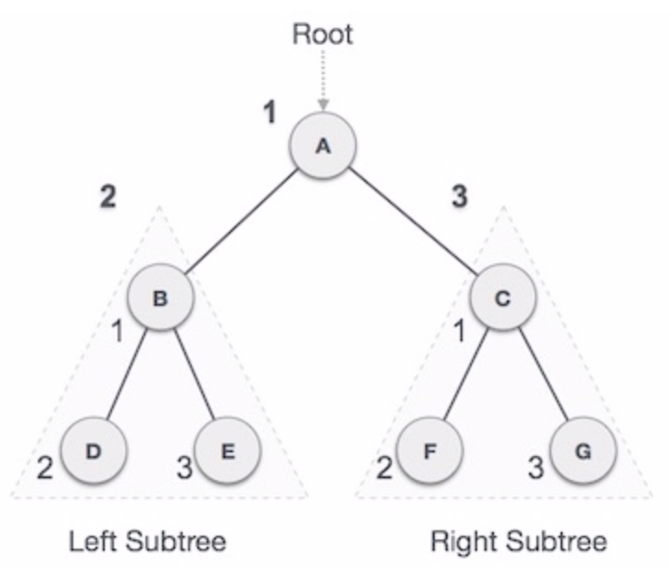
Standard traversal orders – Pre-Order
Pre-order Traversal - root , left subtree, right subtree
Good for copying trees
General description of traversal order:
General
In Python
Example without recursion:
here

Slide 15
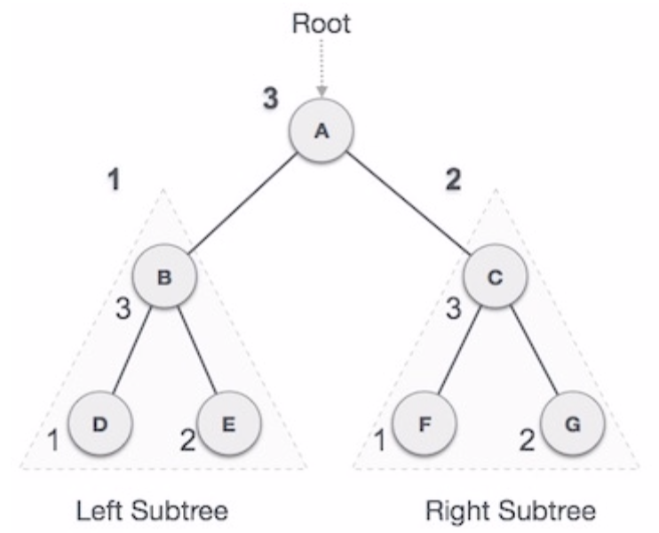
Standard traversal orders – Post-Order
Post-order Traversal - left subtree, right subtree, root
Good for deleting trees (where you’re responsible for it)
A bit more complex without recursion, can be done easily with two stacks
Example without recursion:
here

Slide 16
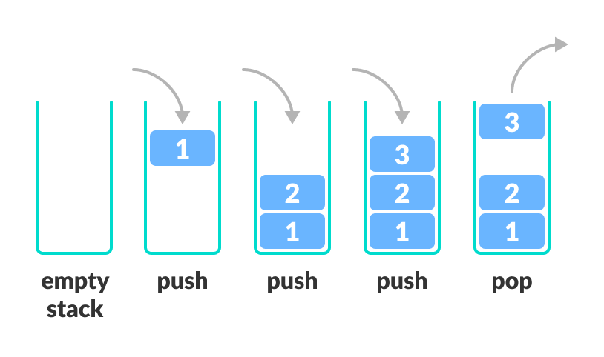
Exercise – Print values sorted
As explained above, getting odered elements can be done using ‘in order traversal’.
This can be implemented using a stack.
In python a stack can be simply implemented using a list with:
pop()
append()

Slide 17
Exercise – Print values sorted
Download the file “g_binary_tree_basic.py” from moodle.
Implement a method “in_order_traversal” for the class.
The method returns the elements of the tree in an ascending order.

Slide 18
Exercise – Print values sorted - solution
def in_order_traversal(self): # Set current to root of binary tree current = self stack = [] # initialize stack result = list() while True: # Reach the left most Node of the current Node if current is not None: # Place pointer to a tree node on the stack # before traversing the node's left subtree stack.append(current) current = current.left # BackTrack from the empty subtree and visit the Node # at the top of the stack; however, if the stack is # empty you are done else: if len(stack) > 0: current = stack.pop() result.append(current.data) # We have visited the node and its left # subtree. Now, it's right subtree's turn current = current.right else: break return result
We go left down the tree to push smalles items to the stack.
When we hit bottom, we start backtracking.
Whenever popping, if possible go right.

Slide 19
Summary
We saw today:
Linked lists
Binary search trees

Slide 20
HW3
In this assignment, we will expand the default python string abilities.
We will focus mostly on different encoding and decoding techniques.
We will create a new string class that will have all the default abilities of the default python string class but will also have some encoding and decoding features.

Slide 21
HW3 - Tasks
Build a class that have the same abilities of the default python str class.
Construct all the relevant exceptions.
Add support for base64.
Add support for cyclic chars encoding.
Add support for cyclic bits encoding.
Add support for byte pair encoding.
Add support for histogram of chars.

Slide 22
HW3 - Tips
You need to construct one class, but feel free to construct more functions or classes.
You will be submitting only one file.
Everything should be self coded. Using the import statement will results in failing the HW.
Read the file in the moodle carefully. Every encoding has its own features and specific implementation features.
A Good solution will be around 200-300 codes.

Slide 23
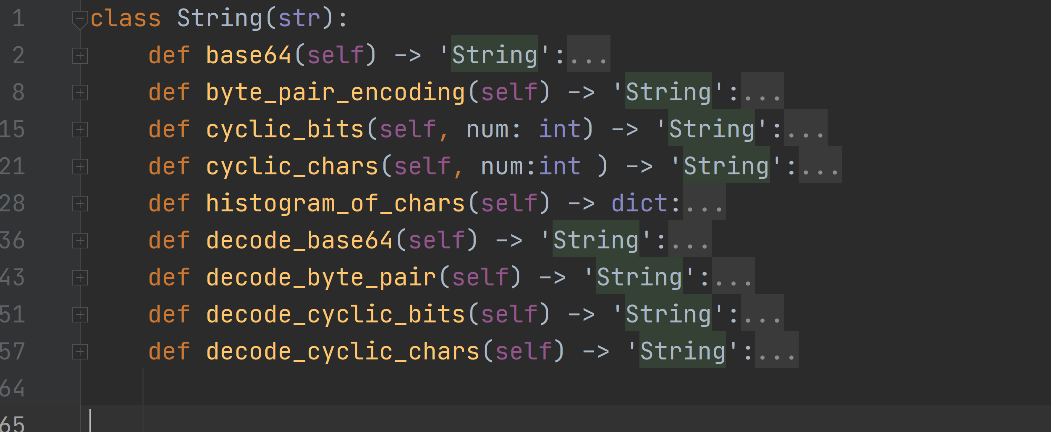
HW3 - prototype

Slide 24
HW3- tests
h = String(“Hello World”)
h_base64 = h.base64()
if h_base64 == "SGVsbG8gV29ybGQ": grade ++
h2 = String(“bla bla”)
h3 = h2 + h
if h3 == " Hello Worldbla bla": grade ++
Etc…

